Slide 1
Input/Output in C++
Chapter 14

Slide 2
Objectives
Use the iostream library for input and output for a
Do formatted I/O with iostreams.
Outline the inheritance hierarchy of the principal streams classes.
Do file I/O using streams.
Overload operators >> and << to do I/O in your own classes.
Gain experience through code walk-throughs and lab exercises.
The example programs are in the chapter directory.
Labs located in Labs/Lab14

Slide 3
Input/Output in C++
The C++ language itself does not define input/output.
Input/output is implemented in a standard library called the iostream library.
The iostream library provides a set of operations for reading and writing of the built-in data types.
The programmer can extend certain of these operations to do input and output of class types.
To use the iostream library include the header file <iostream> .

Slide 4
Built-in Stream Objects
Input stream object, belonging to class istream:
cin standard input
Output stream objects, belonging to class ostream:
cout standard output
cerr standard error (unbuffered)
clog standard error (buffered)

Slide 5
Output Operator <<
Output is performed by the insertion operator <<.
Built-in types such as int, char, char* are supported:
cout << 97;
cout << 'A';
cout << "Hello";
Insertion operations can be concatenated into a single statement:
cout << 97 << 'A' << "Hello";
endl can be used for newline, has the effect of flushing the buffer :
cout << "Hello, world" << endl;

Slide 6
Input Operator >>
Input is performed by the extraction operator >>.
You do not need to use & as with C scanf function.
int num;
cin >> num;
Note direction suggested by << and >>:
cout << num (num ---> output)
cin >> num (input ---> num).
Extraction operator, like insertion operator, can be concatenated:
cin >> num1 >> num2;

Slide 7
Character Input
Extraction operator >> skips over white space.
char ch;
while (cin >> ch) // false at EOF
To read individual characters including blanks, use member function get.
char ch;
while (cin.get(ch))
To read a string or a line use getline (see echostr as an example)

Slide 8
String Input
Extraction operator >> applied to a char * variable reads a string delimited by white space.
A null byte is appended to string.
char buf[80];
for (int i = 0; i < 3; ++i){
cin >> buf;
cout << buf << endl;
}

Slide 9
Formatted I/O
The iostream library supports a very extensive set of formatting facilities.
One programming example is presented on the next page.
A workable strategy for C programmers is to use the C functions sprintf and sscanf for formatting to/from strings, and to use the iostream library for the actual I/O:
float x;
char buf[80];
sprintf(buf, "%10.4f", x);
cout << buf;

Slide 10
Formatted I/O Demo
Review and run the example in the format folder.

Slide 11
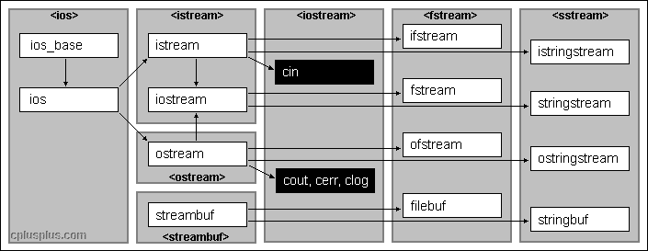
Streams Hierarchy (Simplified)

Slide 12
File I/O
Include header file <fstream>
Output file stream class ofstream
Constructor
<<, other operators
open, close
Input file stream class ifstream
Constructors
>>, other operations
open, close

Slide 13
File Opening
Constructor can both create a stream and open file:
ofstream out("file1.out");
Constructor can create stream and subsequently connect stream to a file:
ifstream in;
in.open("file1.in");
in.close();

Slide 14
File Opening (continued)
Test for success of open operation by checking for non-zero stream:
ofstream in("nofile.xxx");
if ( ! in ) { /* error in opening file */ }
Non-default file opening modes can be specified by an optional argument using enumeration constants in class ios:
ofstream out("file.out", ios::app);// opens in append mode

Slide 15
File Copy demos
Review and run the example in the intcopy folder.
Review and run the example in the charcopy folder.

Slide 16
Demo Overloading Stream Operators
C++ is able to input and output the built-in data types using the stream extraction operator >> and the stream insertion operator <<.
The stream insertion and stream extraction operators also can be overloaded to perform input and output for user-defined types like an object.
It is important to make operator overloading function a friend of the class because it would be called without creating an object.
Review and run the sample program in the StringIO folder.

Slide 17
Summary
Input/output is implemented in C++ in a standard library called the the iostream library.
Built in streams cin, cout, cerr are available.
File I/O can be performed by defining new streams via a constructor.
Output can be performed by insertion operator << and input by the extraction operator >>.
Additional I/O operations include get, put, getline.
I/O is supported for standard data types such as char, int, char *, etc.
The I/O operations can be overloaded to be used with user defined types.

